Slide 1
11490 - The Cat Society

Slide 2
Outline
Description
Cat Structure
Main function
Compare Function

Slide 3

Description
Wild cats take care of each other in the wild.
However, when the winter comes, the preys are not enough to feed all the cats.
Therefore, the cats dine according to the order of their occupations. The order is as follows:
elder (對族貓貢獻良多的長老)
nursy (懷有身孕的母貓)
kitty (可愛的小貓)
warrior (戰士)
apprentice (見習生)
medicent (巫醫)
deputy (副族長)
leader (族長)

Slide 4
Description
In the tradition of the cat society, three different cats serve as the medicent, the deputy, and the leader respectively.
As for the other cats, except that the apprentices (見習生) have the dining priority of the young over the old, for the other occupations, the old have higher priority.
If the occupations and the age of two or more cats are the same, they will dine in lexicographic order according to their names

Slide 5
Input & Output
Input
There are multiple test cases.
The first line of each test case contains two integers N and M, indicating the number of cats and the portions of food respectively, where 0<N,M<=10000.
The next N lines are the information of each cat, including name, occupation, and age. The length of the names will not exceed 30 letters and will contain no spaces.
Output
Please output the cats that could eat the food in order, each name a line.

Slide 6
Sample Input & Output
Sample Input
5 3
Firestar leader 36
Dovekit kitty 3
Leafpool warrior 20
Mousefur elder 40
Graystripe warrior 36
Sample Output
Mousefur
Dovekit
Graystripe

Slide 7
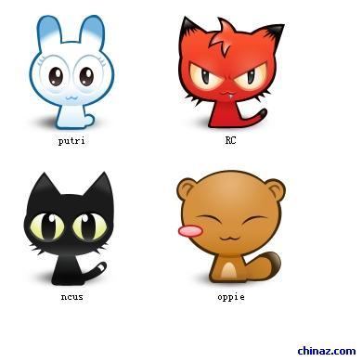
Dining priority
high
elder
nursy
kitty
warrior
apprentice
medicent
deputy
leader
elder 10
nursy 10
nursy 8
The older have higher priority
priority
The younger have higher priority
Only have one
low

Slide 8
Flow Chart
input and store the cats’ information
create cat structure
sort the array of cats
compare the cats’ occupation
output the result
Output the first M results
turn occupation into integer
compare the cats’ age
compare the cats’ name

Slide 9
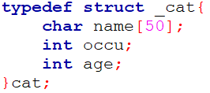
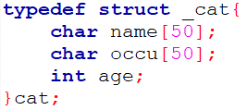
Cat Structure
Turning the occupation strings into integers in the compare function will take too much time.

Slide 10
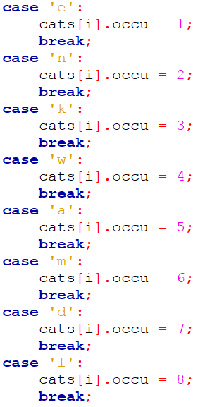
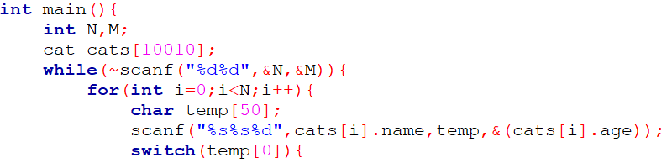
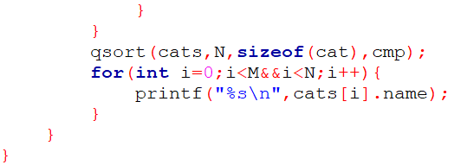
Main Function
．．．

Slide 11
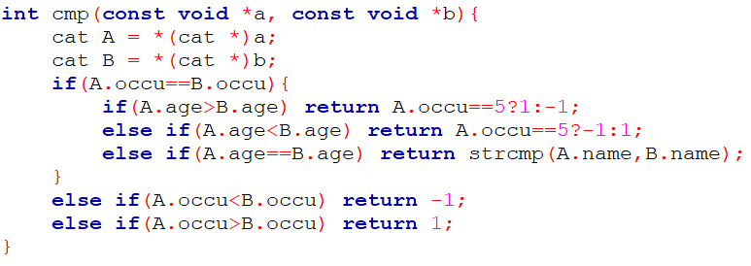
Compare Function
strcmp(x,y) :
return -1 → x<y in lexicographic order
return 1 → x>y in lexicographic order
return 0 → x=y in lexicographic order
qsort compare function :
return -1 → a<b
return 1 → a>b
return 0 → a=b
step1. Compare the cats’ occupation
step2. Compare the cats’ age
step3. Compare the cats’ name

